Slide 1

HEALTHIER FATS AND OILS
A healthier approach to dietary fats
Rohan Singh (107)
Yashika Bhardwaj (161)
Ramjas College, University of Delhi
Bsc(H) Chemistry, Sem-6, Sec-B
1

Slide 2
Concepts
Introduction
Fatty Acids (FA)
Undesirable Reactions
Plant based Oils
Summary
Fats and Oils
General
Chemical
Types of FA
Saturated FA
Unsaturated FA
Chain Length
Common FA
ω-3 and ω-6 FA
ω-6 : ω-3 Ratio
Good and Bad Fats
Composition of some Common Fats and Oils
Deep Frying
Rancidity
Mustard oil
Canola and Olive oil
Soya bean and Sunflower oil
Peanut and Coconut oil
Butter and Vanaspati Ghee
Conclusion
References
Introduction
click on an index entry to navigate to respective slide
2

Slide 3
Introduction
General
Fats and oils are considered as essential nutrient in our diet. All fats are not bad, in fact, healthy fats are essential to manage our body systems, maintain our mental health, fight fatigue and even control weight.
They provide us with the most concentrated source of energy along with essential fatty acids that act as precursors to important hormones, the prostaglandins.
They act as carriers for many fat soluble vitamins and make our food more palatable.
Healthy fats are vital for proper brain development and function as the human is nearly 60% fat.
3

Slide 4
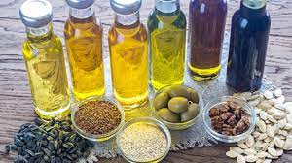
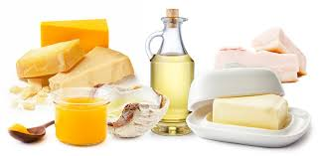
So our first task is to understand the chemistry of fats, type of fatty acids contained in fats from which we can decide which fat is good and which is bad for health.
According to public health recommendations in 1977 in US, fat intake should be reduced to as low as 30% of calories to lower the incidence of CAD. Whereas according to current recommendations the Trans fats, saturated fats and cholesterol intake should be kept as low as possible while consuming a nutritionally adequate diet.
This review summarizes chemistry of fats and oils along with findings and observations on the role of good fats however also discussing the harmful effects of saturated and trans fats and the oils rich in certain kind of fats so that one can choose the right oil.
4

Slide 5
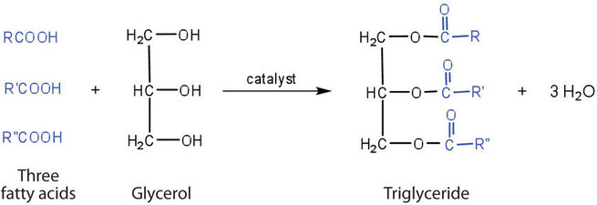
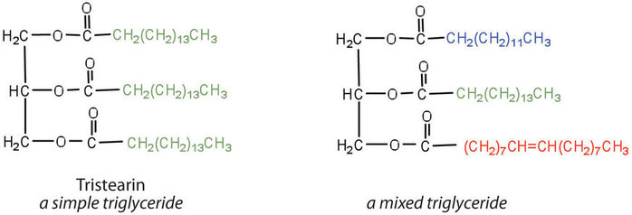
Chemical
Chemically, Fats and oils are called triglycerides (or triacylcylgerols) as they are esters of three fatty acid units joined to glycerol, a trihydroxy alcohol.
A triglyceride is called a fat if it is a solid at 25°C and oil if it is a liquid.
If all three OH groups on the glycerol molecule are esterified with the same fatty acid, the resulting ester is called a Simple Triglyceride.
However, natural fats and oils are mostly Mixed Triglyceride, composed of two or three different fatty acid components.
5

Slide 6

Fatty Acids
Fatty acid is a carboxylic acid with a long aliphatic chain, which is either saturated or unsaturated.
Most naturally occurring fatty acids have an unbranched chain of an even number of carbon atoms, from 4 to 28.
Fatty acids are usually not found in organisms in their standalone form, but instead exist as three main classes of esters, namely triglycerides, phospholipids, and cholesteryl esters.
In any of these forms, fatty acids are both important dietary sources of fuel for animals and they are important structural components for cells.
Fatty acid structure has 2 ends, one is the –COOH end (or ∆ end) and other is –CH₃ end (or ω end).
IUPAC C-x numbers are in blue. The omega-minus "ω−x" labels are in red
6

Slide 7
Types of Fatty Acids
SATURATED (SFA)
UNSATURATED (UFA)
PUFA
MUFA
Based on degree of unsaturation
Based on geometrical isomer
CIS
TRANS
based on chemical nature
based on chain length
FATTY ACIDS
SHORT CHAIN
MEDIUM CHAIN
LONG CHAIN
VERY LONG CHAIN
7

Slide 8
Saturated Fatty Acids
Saturated Fatty Acids (SFA) are those fatty acids which have purely saturated aliphatic alkyl chain (no double bonds).
Due to their saturated alkyl side chain, they do not have bends in their structure. This fact enables them to easily stack over one another and pack closely resulting in their hard, mostly solid state.
They usually have high melting point, and can clog up arteries when consumed in excessive amounts.
They increases LDL (Low Density Lipoprotein also known as bad cholesterol) levels in blood resulting in various heart related diseases and strokes.
Saturated fatty acids are very stable and have good shelf life i.e. they do not readily become rancid.
Most of the animal fats such as meat, butter, cream and cheese contain comparatively high proportion of saturated fat so should be consumed with restraint. Baked goods such as cakes, biscuits and pastries also have high amounts of saturated fat.
8

Slide 9
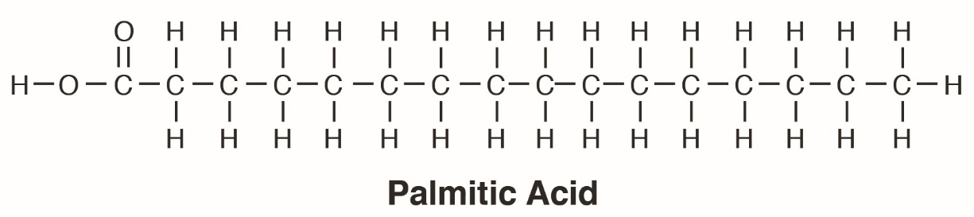
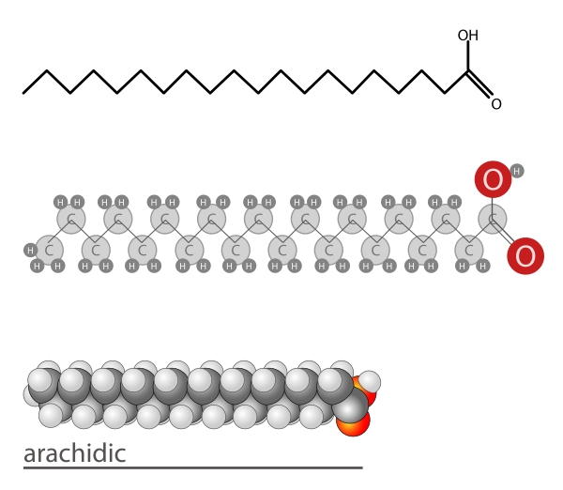
Common name | Chemical structure | C:D
Carprylic acid | CH₃(CH₂)₆COOH | 8:0
Carpric acid | CH₃(CH₂)₈COOH | 10:0
Lauric acid | CH₃(CH₂)₁₀COOH | 12:0
Myristic acid | CH₃(CH₂)₁₂COOH | 14:0
Palmitic acid | CH₃(CH₂)₁₄COOH | 16:0
Stearuc acid | CH₃(CH₂)₁₆COOH | 18:0
Arachidic acid | CH₃(CH₂)₁₈COOH | 20:0
Behenic acid | CH₃(CH₂)₂₀COOH | 22:0
Lignoceric acid | CH₃(CH₂)₂₂COOH | 24:0
Cerotic acid | CH₃(CH₂)₂₄COOH | 26:0
Palmitic Acid
Arachidic acid
9

Slide 10
Unsaturated Fatty Acids
Mono Unsaturated Fatty Acid (MUFA)
Fatty acids in this category have one double bond in their hydrocarbon chain. They are considered as the best type of fat to eat in nutritional terms since they are comparatively stable to oxidation and the development of rancidity. The olive oil and rapeseed oils are the most common source of monounsaturated fatty acids.
Poly Unsaturated Fatty Acid (PUFA)
Polyunsaturated fatty acids contain two or more double bonds in their hydrocarbon chain. They are least stable fatty acids and are highly prone to oxidation. So they are best used in cold applications. The sunflower seed oil is the most common source of polyunsaturated fatty acids
10

Slide 11
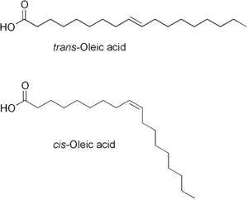
cis-unsaturated fatty acids (CFA)
Unsaturated fatty acids which have one or more double bonds in cis-geometric form falls under this category.
They have a special structural feature, namely bend (or knick) which hinders them from effective stacking and close packing unlike saturated fatty acids.
Net effect of this is a much lower melting point, soft physical state and health benefits. They are considered much healthier than their saturated or trans-counterparts and are believed to lower risks of heart diseases.
trans-unsaturated fatty acids (TFA)
Unsaturated fatty acids which have one or more double bonds in trans-geometric form falls under this category.
These are similar in structure to their saturated counterparts, having straight aliphatic side chain, efficient stacking and close packing resulting in higher melting point.
Heath wise, these are even more harmful then SFA’s as they lower HDL (High Density Lipoprotein or good cholesterol) level in addition to increasing LDL level of blood.
Mostly obtained naturally from animal fats, but can result from partial hydrogenation of vegetable oils that is accompanied by isomerisation of cis-isomers into trans.
11

Slide 12
Some common unsaturated fatty acids
Common name | Chemical structure | Δ^{x} | C:D | IUPAC | n−x
Myristoleic acid | CH₃(CH₂)₃CH=CH(CH₂)₇COOH | cis-Δ⁹ | 14:1 | 14:1(9) | n−5
Palmitoleic acid | CH₃(CH₂)₅CH=CH(CH₂)₇COOH | cis-Δ⁹ | 16:1 | 16:1(9) | n−7
Sapienic acid | CH₃(CH₂)₈CH=CH(CH₂)₄COOH | cis-Δ⁶ | 16:1 | 16:1(6) | n−10
Oleic acid | CH₃(CH₂)₇CH=CH(CH₂)₇COOH | cis-Δ⁹ | 18:1 | 18:1(9) | n−9
Elaidic acid | CH₃(CH₂)₇CH=CH(CH₂)₇COOH | trans-Δ⁹ | 18:1 |  | n−9
Vaccenic acid | CH₃(CH₂)₅CH=CH(CH₂)₉COOH | trans-Δ¹¹ | 18:1 |  | n−7
Linoleic acid | CH₃(CH₂)₄CH=CHCH₂CH=CH(CH₂)₇COOH | cis,cis-Δ⁹,Δ¹² | 18:2 | 18:2(9,12) | n−6
α-Linolenic acid | CH₃CH₂CH=CHCH₂CH=CHCH₂CH=CH(CH₂)₇COOH | cis,cis,cis Δ⁹,Δ¹²,Δ¹⁵ | 18:3 | 18:3(9,12,15) | n−3
12

Slide 13
Chain length of Fatty Acids
Small and Medium Chain
Small Chain (SCFA < C5) and Medium Chain (MCFA C6-C12) Fatty acids have small number of C-atoms in their side chain.
This allows them to have higher solubility and to be directly absorbed in blood stream and metabolised for instant requirement of energy for the body.
They do not affect blood cholesterol levels (neither of LDL or HDL) and serum triglyceride concentration, hence have no risks of heart related problems.
Long and Very Long Chain
Long Chain (LCFA C13-C21) and Very Long Chain (VLCFA > C21) Fatty acids have relatively higher number of C-atoms in their side chain.
Due to their large size and low solubility, they can’t be absorbed directly and must be transported to liver for storage and metabolism.
They contribute to blood cholesterol (mainly LDL), serum triglyceride concentration and accumulated fat in body, all of which result in various health problems.
13

Slide 14
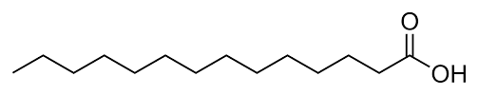
Common Fatty Acids
Lauric and Myristic Acid
Lauric acid and Myristic acid are both saturated fatty acids with chain length of 12 and 14 C-atoms respectively.
These are Medium-Long chain fatty acids observed to be the most blood cholesterol (mainly LDL) increasing fatty acids among saturated fatty acids. This effect is found to be higher in case of Myristic acid than Lauric acid.
Coconut oil and palm kernel oil are major sources of these fatty acids
Lauric Acid (C-12)
Myristic Acid (C-14)
14

Slide 15
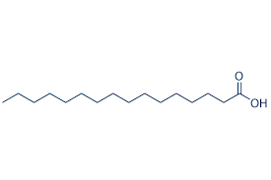
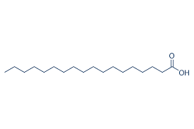
Palmitic Acid
Palmitic acid is a long chain saturated fatty acid with 16 C-atoms.
It has lower effect on increasing serum cholesterol and LDL cholesterol as compared to Lauric acid and Myristic acid.
Main sources of Palmitic acid are Palm oil and lard.
Palmitic Acid (C-16)
Stearic Acid
Stearic acid is a long chain saturated fatty acid with 18 C-atoms.
It is much healthier and most popular saturated fatty acid, that has no effect on plasma lipids.
Cocoa butter and shea butter contain about 40% of stearic acid.
Stearic Acid (C-18)
15

Slide 16
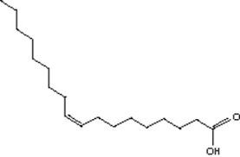
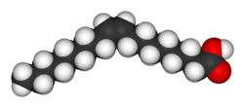
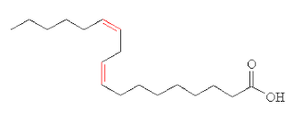

Oleic Acid
Oleic acid is a naturally occurring mono-unsaturated ω-9 fatty acid, abbreviated with a lipid number of 18:1 cis-9. It is most common fatty acid in nature.
Oleic acid comprise the majority of olive oil. Free oleic acid renders olive oil inedible. It also makes up 59–75% of pecan oil, 61% of canola oil, 36–67% of peanut oil, 60% of macadamia oil, 20–80% of sunflower oil,15–20% of grape seed oil, sea buckthorn oil, 40% of sesame oil, and 14% of poppyseed oil.
Linoleic Acid
Linoleic acid is a poly-unsaturated ω-6 fatty acid, with 2 C=C double bonds, lipid number of 18:2 cis-9 cis-12.
Linoleic acid is essential for good health and is termed as an essential fatty acid. It cannot be synthesized by human body from food components.
The common vegetable oils rich in Linoleic acid are evening primrose oil, grape seed oil and safflower oil.
16

Slide 17
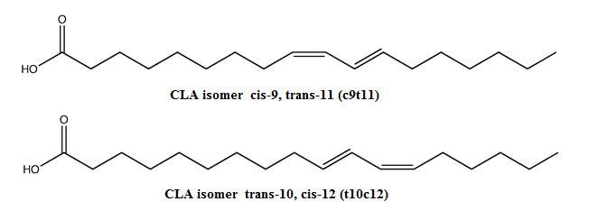
Conjugated Linoleic Acid (CLA)
Conjugated Linoleic Acid (CLA) is a name used to refer positional and geometric isomers of Linoleic acid.
These are found in animal fats such as lamb, beef, and dairy products. CLA are obtained on microbial fermentation of PUFAs and isomerization of linoleic acid.
cis and trans combinations have shown that conjugated linoleic acid have been found in many clinical studies to have physiological effects such as anticarcinogenic, antiatherogenic, checking of type II diabetes, and immunomodulating properties of CLA.
Conjugated linoleic acid has been observed to be quite effective to inhibit the growth and metastasis of prostate and breast cancers in some clinical studies on animals.
17

Slide 18
ω-3 and ω-6 Fatty acids
ω-3 (or N-3) fatty acids are a group of PUFA, which are considered good for health. They are one of the two essential fatty acids comprising Linolenic acid (lipid no 18:3 cis-9, cis-12, cis-15) which cannot be synthesized in human body and has to be taken from diet.
Oily fish from near polar regions are a good source of ω-3 fatty acid. Seeds of the Brassica family, such as mustard (6- 11%), canola, rapeseed (7%) and turnip, have high amounts of omega-3 fatty acid.
ω -6 (or N-6) fatty acids are also vital for good health. They comprise the essential fatty acid Linoleic acid (lipid no 18:2 cis-9, cis-12), which is ample in vegetable oils like corn (60%), sunflower (50%) oil and cottonseed (50%).
Margarine is very high in omega-6 fatty acids. N-6 fatty acids are precursors to pro-inflammatory compounds in the body. Moreover, consumption of ω-6 fatty acids in large quantities suppresses the effect of ω-3 fatty acids.
18

Slide 19
ω-6 : ω-3 Ratio
ω -6 (or N-6) and ω-3 (or N-3) both are essential for proper functioning of body, but they should be present in balanced proportion in the body. ω-6 and ω-3 compete for the enzymes which convert them into biologically more active compounds.
Hence, when more ω-6 is consumed, it uses proportionately more of those enzymes, eventually resulting into a more pro inflammatory environment.
As per Institute of Medicine an appropriate intake (AI) for ω-6 is about 10 to 15 grams a day. The AI for ω-3 is at least 1 to 2 grams per day. Although appropriate intakes are estimations and are found to vary with age, gender, life stage, activity level etc., but the ratio in the diet is recommended to be less than 4:1.
World Health Organization (WHO) recommends N-6: N-3 ratio to be 5:4 and many organizations consider optimum ratios to be closer to 1:1.
19

Slide 20
Good and Bad Fats
Eating Mono-unsaturated (MUFA) and Poly-unsaturated (PUFA) fats in food lower the risk of health problems and heart diseases. It also helps in lowering LDL (bad cholesterol) levels and can contribute towards HDL (good cholesterol) level of blood. Foods rich in unsaturated fats include vegetable oils such as olive, canola, sunflower, soy, corn etc, nuts, seeds, and fish.
On another hand, high consumption of Saturated fats (SFA) or Trans Fats (TFA) can potentially increase blood LDL levels, causing series of health problems and increased risks of heart strokes.
Trans fats are even more harmful than SFA’s. They are side products of hydrogenation of unsaturated fats and oils (margarine or vegetable oils) e.g Vanaspati ghee.
In case of incomplete hydrogenation (partial hardening), the comparatively high temperatures used in the process have tendency to flip some of the carbon double bonds into the trans form. These particular bonds will still be present in the final product as trans-fatty acid if they escape hydrogenation in the process.
It is the most harmful type of fat for health and has been related with development of CAD because TFA also lowers HDL in addition to increasing LDL like SFA.
20

Slide 21
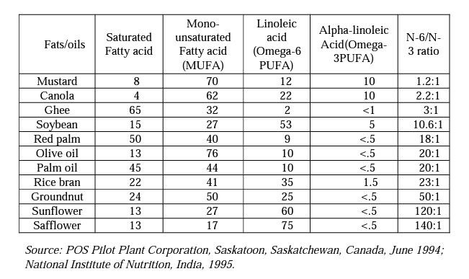
Common Fats and Oils
 | Lauric |  | Myristic | Palmitic | Stearic | Oleic | Linoleic | Linolenic
Fats
butter (cow) | 3 | 11 |  | 27 | 12 | 29 | 2 | 1
tallow |  | 3 |  | 24 | 19 | 43 | 3 | 1
lard |  | 2 |  | 26 | 14 | 44 | 10
Oils
canola oil |  |  |  | 4 | 2 | 62 | 22 | 10
coconut oil | 47 | 18 |  | 9 | 3 | 6 | 2
corn oil |  |  |  | 11 | 2 | 28 | 58 | 1
olive oil |  |  |  | 13 | 3 | 71 | 10 | 1
peanut oil |  |  |  | 11 | 2 | 48 | 32
soybean oil |  |  |  | 11 | 4 | 24 | 54 | 7
21

Slide 22
Undesirable Reactions
Deep Frying
Heating oil too much (up to its smoking point) may change the chemical composition of the oil which becomes harmful to our health when we ingest it and even inhale its fumes.
When we heat fats and certain foods such as fatty meats at very high temperatures (deep-frying), or barbecuing and stir-frying on very hot surfaces, polycyclic aromatic hydrocarbons (PAHs) may be formed which are supposed to be carcinogenic. Advanced Glycation End Products (AGEs) are also formed when foods mainly meat and potato chips are browned. These chemicals are believed to be related with an enhanced risk of age-related diseases such as Alzheimer's, heart disease, stroke and cataracts.
Also refined oils (plain olive oil, canola and sunflower) have a higher smoke point, so they can be heated to a higher temperature before beginning to burn and smoke.
22

Slide 23

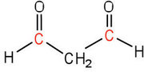
Rancidity
Fats and oils that are in contact with moist air at room temperature eventually undergo oxidation and
Hydrolysis reactions that cause them to turn rancid, acquiring a characteristic disagreeable odour.
Hydrolytic Rancidity
One cause of the odour is the release of volatile fatty acids by hydrolysis of the ester bonds.
Butter, for example, releases foul-smelling butyric, caprylic, and capric acids.
Microorganisms present in the air furnish lipases that catalyze this process.
Hydrolytic rancidity can easily be prevented by covering the fat or oil and keeping it in a refrigerator.
Oxidative Rancidity
Another cause of volatile, odorous compounds is the oxidation of the unsaturated fatty acid components, particularly the readily oxidised structural unit in PUFA’s such as linoleic and linolenic acid.
One particularly offensive product, formed by the oxidative cleavage of both double bonds is malonaldehyde.
It can be prevented by adding antioxidants.
23

Slide 24
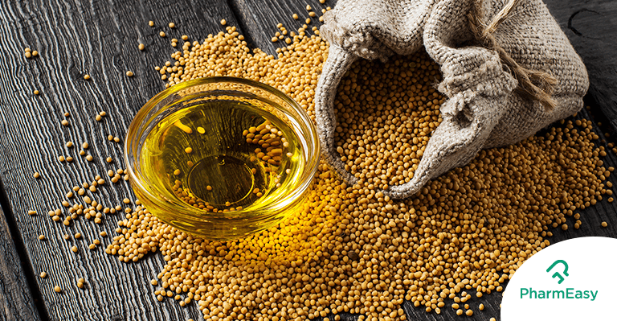
Plant based Oils
Mustard Oil
Mustard Oil contains nearly 70 % MUFA with 42 % of erucic acid and 12 % of oleic acid, it has 22 % PUFA content of which 10 % is the ω-3 linolenic acid, 12 % ω-6 linoleic acid and 8 % SFAs.
Mustard oil having high levels of ω-3 (10 %) is a common, cheap, mass-produced vegetarian source of ω-3 fatty acids.
Once it was considered unhealthy for human consumption due to high percentage of erucic acid in it. Now a days mustard oil is considered as one of the healthiest edible oils because it contains low proportion of SFAs (only 8%) and a high proportion of MUFA and PUFA fatty acids (92%), which are good for health
24

Slide 25
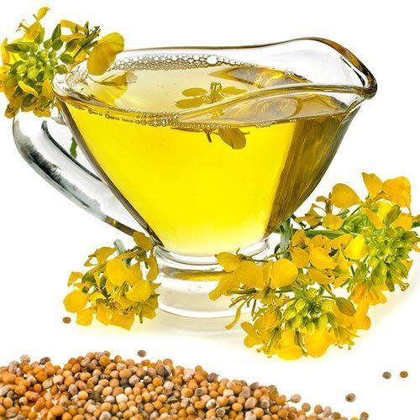
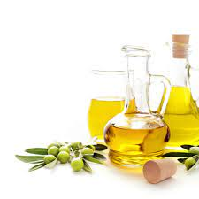
Canola Oil
Canola (or Rapeseed) oil is a plant-based oil, considered to be a close relative of mustard (Brassica family) as it also has low in SFA content (less than 7%), high MUFA content and contains a beneficial ω-3 fatty acid profile.
It is considered good for human consumption by many health professional organizations including the American Dietetic Association (ADA), and American Heart Association (AHA)
Olive Oil
It has highest MUFA content (75 %) among all other oils, which results in lowering of LDL and elevation of HDL cholesterol which causes decrease in the risk of CAD. it exerts anti-inflammatory, antithrombotic, antihypertensive as well as vasodilatory effect.
Extra-virgin olive oil contains the highest concentration of polyphenolic antioxidants (oleuropein or tyrosol) which leads to increased arterial elasticity and decreased risk of stroke and heart attacks.
It also shows a protective effect against certain malignant tumor's in the breast, endometrium, prostate and digestive tract.
25

Slide 26
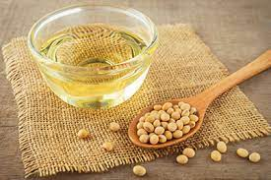
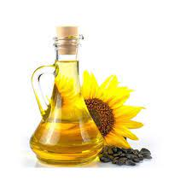
Soya bean Oil
It is one of the most widely consumed cooking oil these days. Like safflower and sunflower oil, it also contains high content of PUFA though in less amount.
The major unsaturated fatty acids in soybean oil are 7–10% linolenic acid, 51% linoleic acid and 23% oleic acid. It has saturated fatty acids (4% stearic and 10% palmitic acid).
As it has a high content of linolenic acid so has tendency to turn rancid earlier therefore it should be used fresh like safflower oil and sunflower oil.
Sunflower Oil
Like safflower oil it is high in PUFA and the essential vitamin E contents and low in unwanted SFA. It is rich in lecithin, tocopherols, 114 Rummi Devi Saini carotenoids and waxes.
It is good cooking oil known for having a clean taste and low levels of trans fat. However, it has a high ω-6 PUFA content.
Some studies have advocated that it may increase the risk of breast and prostatic cancer. It has a very poor N-6/N-3 ratio of 120:1
26

Slide 27
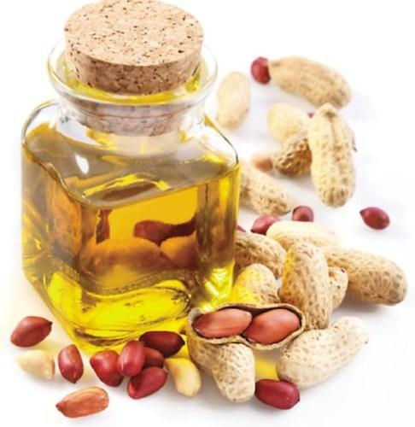
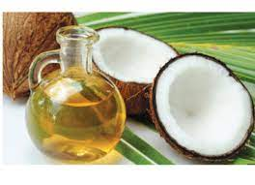
Peanut Oil
It is most often used in Chinese, South Asian and Southeast Asian cuisine. Peanut oil is appreciated for its high smoke point comparative to many other cooking oils.
it has a good taste. Its main constituent fatty acids are oleic acid (MUFA), linoleic acid (PUFA), and palmitic acid (SFA). The oil also comprises some stearic acid, arachidic acid, arachidonic acid, behenic acid, lignoceric acid and other fatty acids.
This is considered the heart friendly oil which is rich in MUFA and has well balance of other constituents
Coconut Oil
Coconut oil has been used in many cultures especially in south India. However coconut oil contains about 90% SFA, which is even a higher than butter (about 64% SFA), beef fat (40%), or lard (40%).
So much SFA in the diet is unhealthy because it raises LDL (bad cholesterol) levels, which increases the risk of heart disease. But coconut oil also raises HDL (good cholesterol) levels.
Though coconut oil's special HDL-boosting effect makes it less bad than the high saturated fat content indicates, but it's still not the preferred choice among the many available oils to reduce the risk of heart disease
27

Slide 28
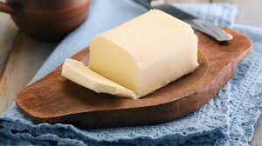
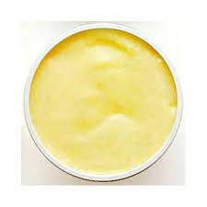
Butter
It is obtained from animal source and has high SFAs and cholesterol contents. It may raise total and LDL cholesterol but may also increase HDL cholesterol.
Being a good flavoring agent it can be used for baking but as it has a low smoke point hence cannot be used for deep frying.
Vanaspati Ghee
It is a hydrogenated refined vegetable oil which has been made more stable. It has more shelf life and has least tendency to turn rancid.
It has a relatively low smoke point so not good for deep frying.
Furthermore, it is considered to be the unhealthiest of all oils because it is devoid of natural vitamins and bio-active compounds due to hydrogenation and refining.
28

Slide 29
Conclusion
In terms of overall health benefits, extra virgin olive oil and canola oil are the best choices, since they are rich in MUFA and antioxidants. They decrease risk of high blood cholesterol levels and cardiac arrest.
Although extra virgin olive oil does contain saturated fat (around 12 %), it is one of the few unrefined oils. This means that the antioxidants present in the original fruit are retained because the oil is extracted by machine only and not refined with chemicals or other means that can remove the goodness from the oil.
While most canola oil products are refined and don't contain many antioxidants, they have the advantage of having even less saturated fat than olive oil (around eight per cent).
A daily amount of these oils recommended is about two to three tablespoons which would be perfect in keeping with a healthy balanced diet and even a weight-loss rule.
For cold dishes (with salads and breads), use of extra virgin olive oil is recommended in order to take advantage of the flavors and antioxidants.
29

Slide 30
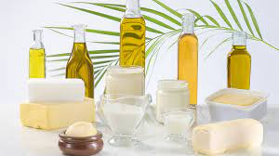
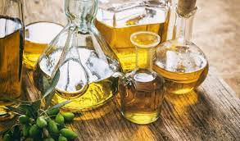
Refined oils such as canola, sunflower and plain olive oil are recommended for cooking (casseroling, sautéing and stir-frying) due to high smoke point.
Peanut oil and other flavored oils such as sesame, macadamia are suggested to be used in dishes that demand certain flavors.
Tropical oils, such as palm, cottonseed and coconut, should be limited because they are naturally more saturated.
It is generally recommended that to achieve best health benefits, oils rich in PUFA should be used in combination with those rich in MUFA like olive oil, mustard oil or groundnut oil.
30

Slide 31
References
Bockisch, M. 1998. Fats and Oils Handbook. American Oil Chemists Society, p. 175–344. Champaign. C
Thormar H, Isaacs EE, Kim KS, Brown HR. Inactivation of visna virus and other enveloped viruses by free fatty acids and monoglycerides. Ann N Y Acad Sci 1994;724:465–71.
Wester I (2000) Cholesterol-lowering effect of plant sterols. European Journal of Lipid Science and Technology 102: 37–44.
https://chem.libretexts.org
https://en.wikipedia.org
31

